Slide 1
FIFA WORLD CUP ANALYASIS (1930-2014)

Slide 2
INTRODUCTION
Welcome to my analysis about FIFA world cup held between year 1930 to 2014
Here we will see the venues of the FIFA world cup held between year 1930-2014. We will see the winners list, fans attendance, total goals, average goals and the venues. We will have a brief analysis about the World's most popular tournament.

Slide 3
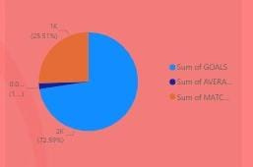
SUM OF GOALS/MATCHES/AVERAGE GOALS

Slide 4
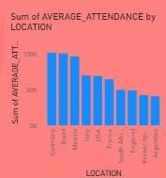
AVERAGE ATTENDANCE BY LOCATION

Slide 5
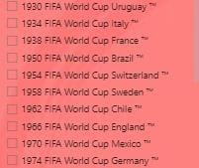
YEARS AND HOST NATIONS

Slide 6
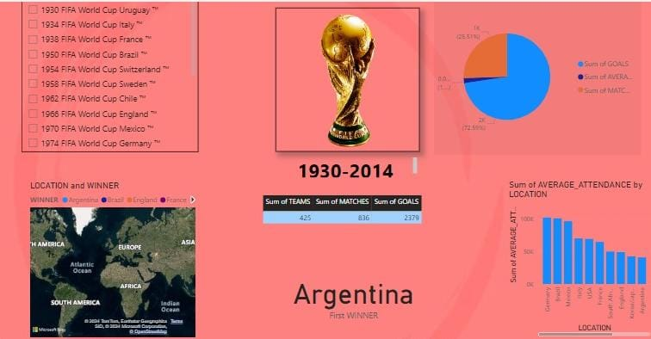
MY DASHBOARD

Slide 7
THANK YOU

